Slide 1
Game Theory
Game theory is the study of mathematical models of strategic interaction among rational decision-makers.
However, only weak application to real-time computer games, but terminology stems from it.
Number of players
Each player’s move called a ‘ply’
One round of each players’ turn called a ‘move’
Goal is typically to win (you win if your opponent loses)

Slide 2
Board Game Properties
Two or more players
Turn based
Zero sum games
Perfect versus Imperfect Information
  Chess, Poker, Monopoly, Checkers, Backgammon
We will focus on two-player, zero-sum, perfect information
Transposition of games states is possible
State space is usually too large to search exhaustively

Slide 3
The Game Tree
Any turn-based game can be represented as a game tree.
Each node represents a board position
Each branch represents one possible move
Each player gets to move at alternating levels on the tree
Board only changes when a player moves

Slide 4
The Game Tree
Branching Factor
Number of branches = Number of possible moves
  e.g. in X’s and O’s its 9 for first move …
  Some games this can be very large
  When this = 0 (Terminal Position) game over
Depth Factor
Maximum number of turns
  X’s and O’s = 9
  Reversi (Othello) ?
  Chess ?
Preference is for small branching factor with deep tree, over shallow tree with huge branching factor
Notes:
Reversi = 60 (8x8 but middle 4 squares are setup)
Chess = Almost Infinite (but limited to the 50 move rule in competition chess)

Slide 5
The Game Tree
Transposition
Sometimes we get to the same board position several times in the same game
Sometimes we get to the same board position via different routes
Game Tree is not a real Tree at all !
  Branches can merge as well as split
  e.g. Nim
Algorithms should be adjusted to handle transposition

Slide 6
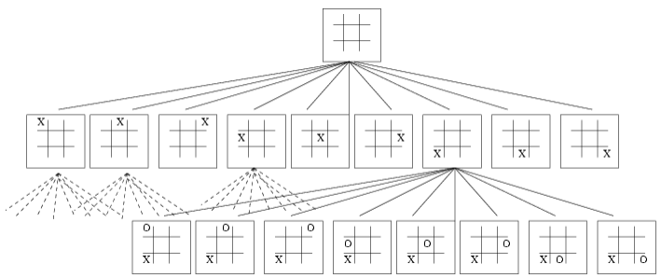
The Game Tree - Example
Example: X’s and O’s
255,168 unique games of Tic Tac Toe to be played.
131,184 are won by the first player
77,904 are won by the second player
46,080 are drawn.

Slide 7
MiniMax Search
Has dominated turn-based AI
Assume two players
  Called Min and Max
Max is trying to win
  We want to MAXIMIZE her advantage
Min is the opponent (also trying to win)
  She wants to MINIMIZE Max’s advantage
Assume:
  Both players have the same knowledge
  Min will always move to a state that is worst for Max
    When I search for responses to my move I must remember this

Slide 8
MiniMax Search
Assume we can score each state in some manner
  Board.Evaluate(player);
Label each level on the search tree according to whose move it is
  Each level is called a ply! (represents one player move)
If Max is parent then choose maximum value state (node) from the child nodes
If Min is the parent then choose minimum value state (node) from the child nodes

Slide 9
MiniMax Algorithm
function MINIMAX(N)
begin
if N is deep enough then
return the estimated score of this leaf
else
Let N1, N2, .., Nm be the successors of N;
if N is a Min node then
return min{MINIMAX(N1), .., MINIMAX(Nm)}
else
return max{MINIMAX(N1), .., MINIMAX(Nm)}
end MINIMAX;

Slide 10
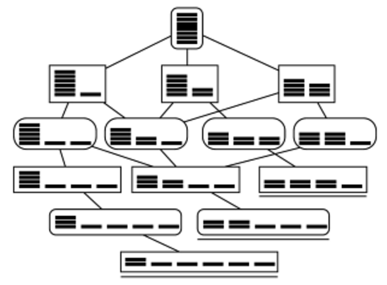
Example – 7 Split-Nim
7 matches/coins are placed in a heap between two players
At each move a player must divide a heap into two heaps with unequal number of matches in each
Assertion: The first player to make a move loses!
  Map space for 7 matches
  Draw Game Tree
  Mark all final states as 0 for loss and 1 for win
  Work backwards to top
Transposition

Slide 11
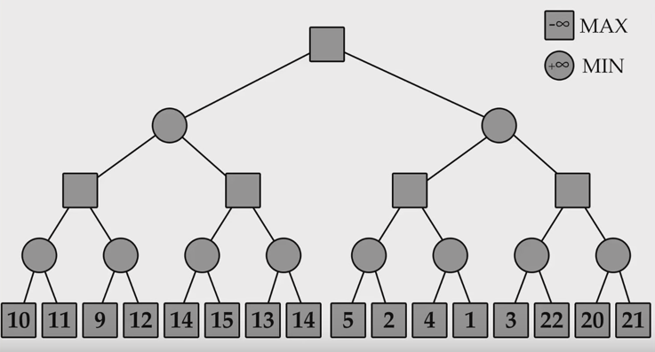
Minimax - Example
MAX is the player (initial best value move set to -∞)
MIN is the computer (initial best value move set to +∞)

Slide 12
Minimax - Performance
Algorithm is:
O(d) in memory
where d = maximum depth of search or depth of tree
O(nd) in time
where n is the number of possible moves at each position
Very inefficient with wide and deep trees.

Slide 13
In Reality
In most games an exhaustive look ahead is impossible
Instead we rely on N-move look-ahead
  Set a depth level
We cannot mark end point as win or lose
  So we estimate it’s worth using a heuristic
Game graphs are searched by PLY (level)
This is determined by space and time considerations

Slide 14
The Game Tree - Example
Example: X’s and O’s
255,168 unique games of Tic Tac Toe to be played.
131,184 are won by the first player
77,904 are won by the second player
46,080 are drawn.
Using minimax how might we evaluate the leaf nodes?

Slide 15
The Static Evaluation Function
Look at the current state of play and score it from one player’s point of view
  Typically a signed integer (why int not float?)
  But within what range?
If board in terminal position then
  score = final score
Simple Move Choice
  Highest evaluation score
  But it’s not that simple !!
Harder to score mid way through game
  Reversi ?
  Chess ?
  GO (see Lee Sedol vs AlphaGo Move 37 reactions and analysis)
We need to look ahead
Notes:
Integer arithmetic is faster than floating point arithmetic on most machines.
The range of scores should be less than the scores for winning or loosing, otherwise the AI will not try to win the game because other moves seem more rewarding.

Slide 16
Example – Chess Evaluate
Checkmate – worth more than rest combined
Simplest is point value for material
  Pawn 1, Knight 3, Bishop 3, Rook 4, Queen 9, King ∞?
But also piece combinations
  Rook and a bishop 8
  Pair of rooks 10
Typically, use weighted function:
  c1*material + c2*mobility + c3*king safety + c4*centre control + ...
What about playing for a draw?
  Can be good (i.e. if opponent is strong)
  Can be bad (i.e. if opponent is weak)
Adjust with contempt heuristic factor
  Makes a draw (0) slightly lower (play to win)
Is the objective really to win??

Slide 17
Horizon Effect
Sometimes our end state is estimated to be very good
  But if we looked another ply ahead we would see that it is disastrous
One solution is to use Extensions
  A form of iterative deepening on the most promising nodes
  In states that look exceptionally good we look deeper
  We can look a number of plies ahead
  Not perfect since we are really just moving the horizon
  Heavily reliant on a good evaluation function

Slide 18
Quiescence Pruning
When play becomes relatively stable then don’t bother with deep searches
  They won’t give us much better information
Instead use time to search wider or most promising nodes
Prune a branch if its heuristic value does not change much over successive searches
  Heuristic value probably very accurate
Combined with Extensions focuses on most promising branches of the search tree

Slide 19
Conclusion
Min-Max is good
  It works
  It is simple
However we need to reduce our search space as much as possible
  Because it is so large
We need a way to prune our search space....

